Slide 1


Regularizing Image Reconstruction for Gradient-Domain Rendering with Feature Patches
M. Manzi D. Vicini M. Zwicker University of Bern

Slide 2
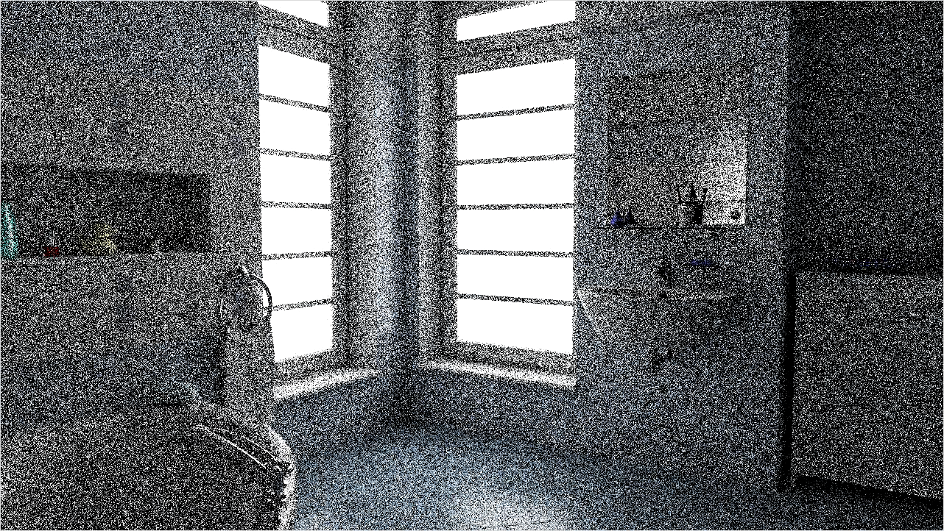
Motivation
error / 2 = time * 4
15min
30min
45min
1h
Notes:
The motivation of our work lies in the slow convergence of Monte Carlo light transport algorithms.
As you can see in this animation unconverged images exhibit high frequency noise that is only reduced by increasing renderingtime.
In order to halve the error we have to increase rendering time by a factor of 4. In the animation you can see this by the lack of visual improvement after around 30 minutes.
Our work now aims at improving the speed of the rendering process to reduce the effective amount of time needed to render a high quality image.

Slide 3
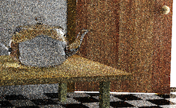
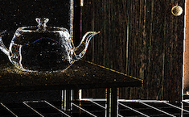
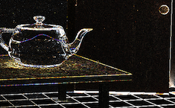
Gradient-domain rendering
[Lehtinen et al. 2013, Manzi et al. 2014, Manzi et al. 2015, Kettunen et al. 2015]
Sampling
Base Image
Gradient Images
Notes:
Our work builds on gradient-domain rendering methods. These methods are a recent approach to significantly reduce the variance of monte carlo path tracing.
Gradient-domain rendering algorithms sample a so called base image like conventional path tracing and additionally image gradients in horizontal and vertical direction.

Slide 4
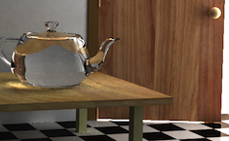
Gradient-domain rendering
[Lehtinen et al. 2013, Manzi et al. 2014, Manzi et al. 2015, Kettunen et al. 2015]
Sampling
Poisson reconstruction
Less variance than naïve path tracing!
Notes:
The base image and the pixel gradients are then combined into one image using a Poisson reconstruction.
The resulting image has significantly less variance than a image computed using conventional path tracing in equal time.
Gradient-Domain rendering was first introduced in the context of metropolis light transport and then extended to both path tracing and bidirectional path tracing variants. In the following I will be talking about gradient-domain path tracing unless specified otherwise. Our work however applies to all flavours of gradient-domain rendering.

Slide 5
Gradient sampling
Base Path
Base Path
Base Path
Base Path
Image pixels
Notes:
I will not go into the details of the sampling of the gradients, but I still would like to give a short overview of the key ideas.
The gradient domain path tracer builds on a standard path tracer, which shoots a number of paths through each pixel. We call these paths base paths.

Slide 6
Gradient sampling
Offset Path
Offset Path
Offset Path
Offset Path
Image pixels
Notes:
To obtain finite difference gradients, we shift each base path to all four neighboring pixels. These new paths are called offset paths. We then get a gradient sample by subtracting the contribution of the base path the contribution of an offset path.

Slide 7
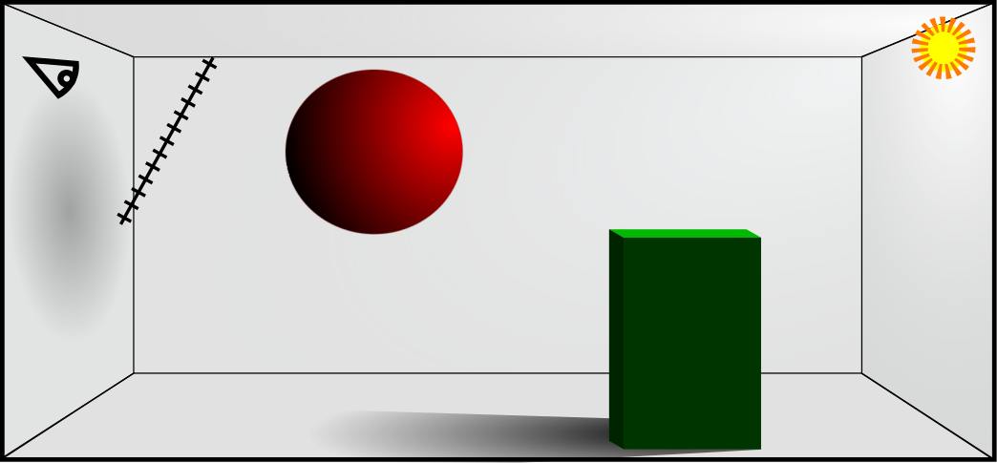
Gradient sampling
Noise cancelled out!
Base Path
Offset Path
Notes:
The offset paths are created by shifting the primary intersection by one pixel and then reconnecting the shifted path as soon as possible back to the base path. Thus all the remaining path segments are the same and the noise from these remaining path segments cancels out when we subtract the offset path contribution from the contribution of the base path.
This means that the values of the sampled gradients and therefore also their variance will typically be small compared to the image values. This is the main reason why we can get lower variance then in conventional rendering.
Reconnecting the shifted path to the base path is not trivial as soon as specular materials are involved. For these cases I refer you to the original papers on gradient-domain rendering.

Slide 8
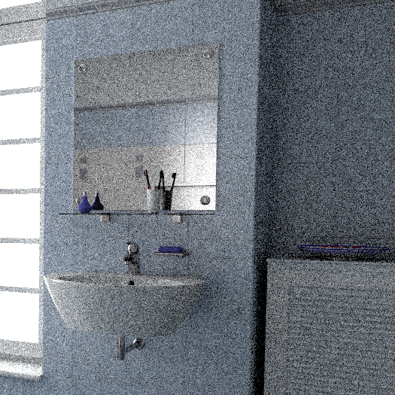

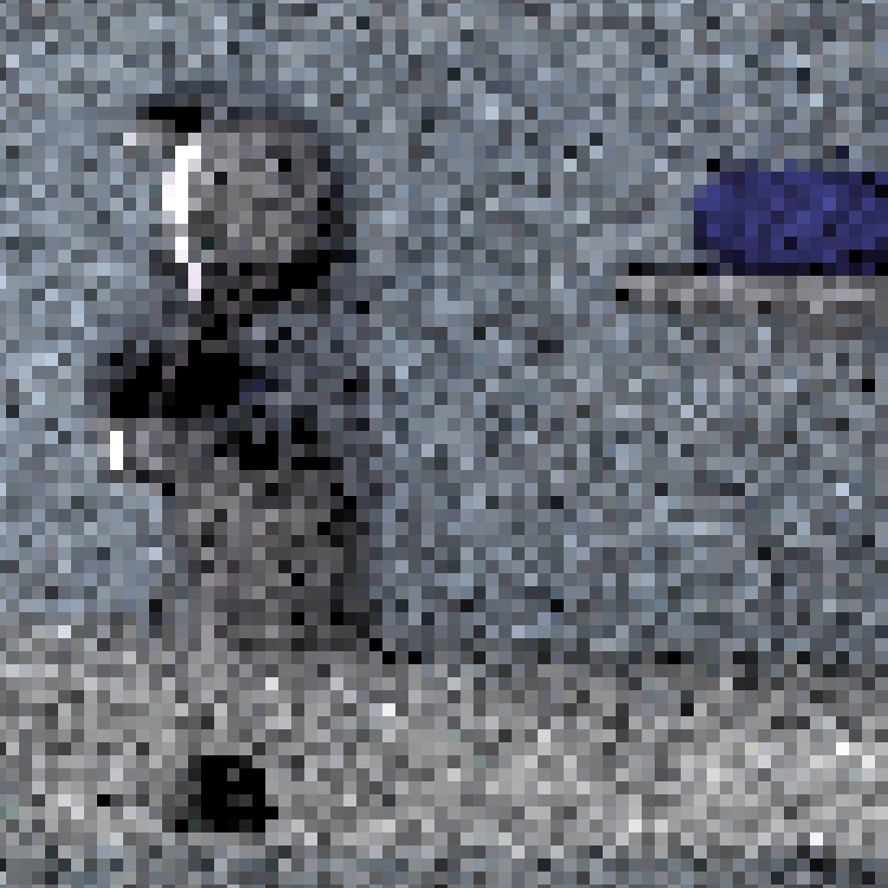
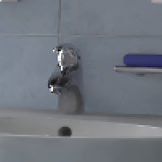
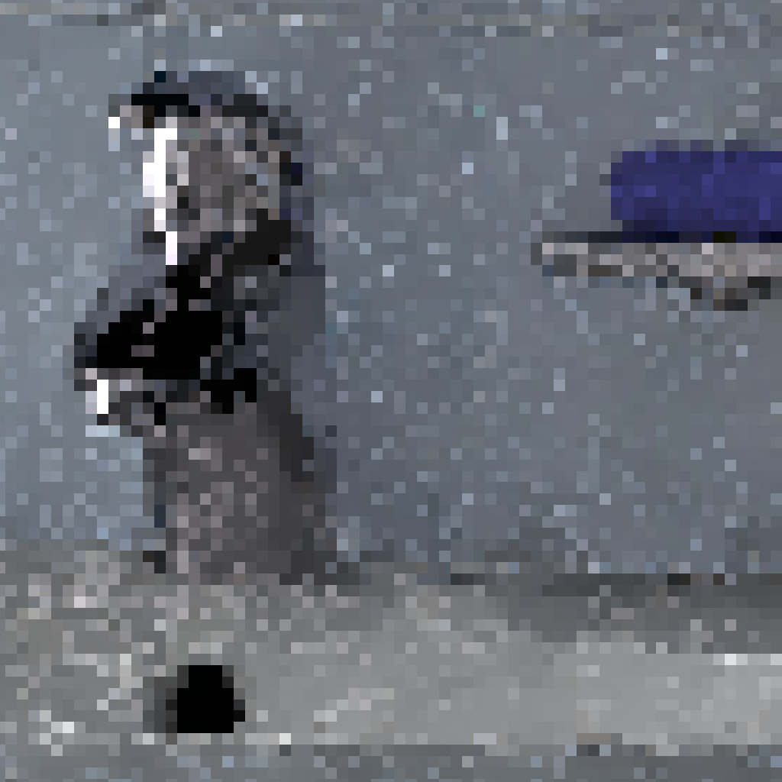
Gradient-domain example
Ours
Path Tracing
Gradient-Domain Path Tracing (L1)
Stilly Noisy!
Notes:
If we compare the output of gradient domain rendering to the output of regular path tracing in equal time, the image generated using gradient-domain rendering has significantly less variance than the path traced image, but still suffers from noise, even at a large number of samples.
In our work, we introduce a new regularized reconstruction for gradient-domain rendering which gets rid of most of the noise.

Slide 9
Our contribution
Extended screened Poisson reconstruction for gradient-domain rendering
Leverages feature patches to regularize solution
An error analysis
Reveals influence of main parameters on bias and variance
Multiscale reconstruction
Scale selection based on error estimation
Up to 5x MSE reduction
Notes:
In our work, we extended the screened poisson reconstruction in order to reduce the variance in the reconstruction. We do this by using small feature patches to regularize the solution.
We also provide an analytical error analysis of our extended reconstruction, which reveals the influence of the main parameters on bias and variance.
Our final reconstruction algorithm then features a multiscale reconstruction pipeline. This means we select between different candidate reconstructions by estimating the error of each reconstruction.
Our work in the end gives a reduction of the mean square error compared to standard gradient domain rendering of up to a factor of 5.

Slide 10
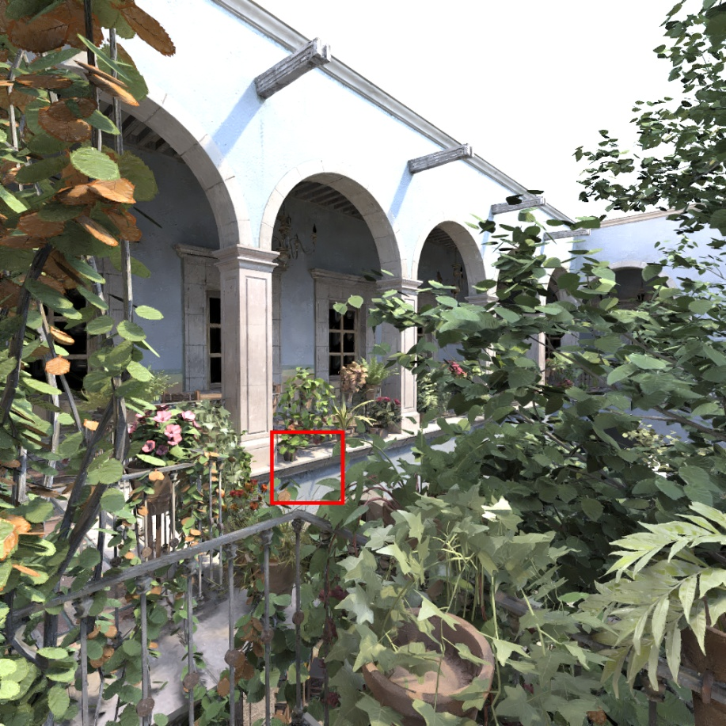
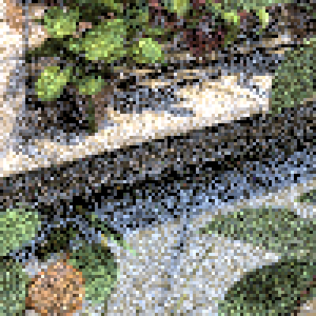
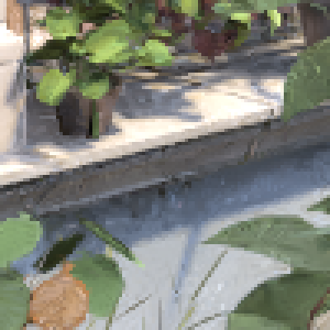
Image-space denoising
[Bauszat et al. 2011, Li et al. 2012, Moon et al. 2014, Rousselle et al. 2013, Kalantari et al. 2015, …]
[Bauszat et al. 2011, Li et al. 2012, Moon et al. 2014, Rousselle et al. 2013, Kalantari et al. 2015, …]
Example: Robust Denoising using Feature and Color Information (RDFC) [Rousselle et al. 2013]
Path tracing 55 s
Denoising 57 s
Notes:
Our approach is heavily inspired by image space denoising methods. These methods try to remove the noise from the rendered image in a post processing step.
In the figure here you can see the result of the “Robust Denoising using Feature and Color Information” algorithm by Rousselle et al. compared to standard path tracing at equal rendering time.

Slide 11
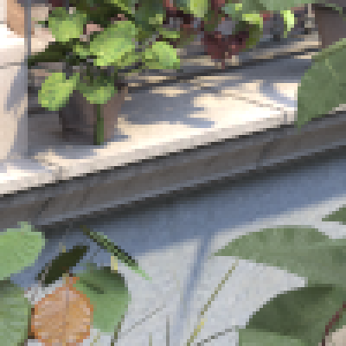
Image-space denoising
[Bauszat et al. 2011, Li et al. 2012, Moon et al. 2014, Rousselle et al. 2013, Kalantari et al. 2015, …]
[Bauszat et al. 2011, Li et al. 2012, Moon et al. 2014, Rousselle et al. 2013, Kalantari et al. 2015, …]
Example: Robust Denoising using Feature and Color Information (RDFC) [Rousselle et al. 2013]
Ground truth ~30 h
Denoising 57 s
Notes:
The denoised result is fairly close to the ground truth, despite being rendered in only 1 minute.

Slide 12
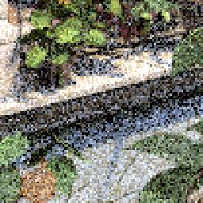

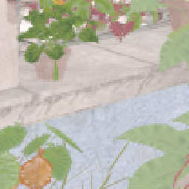
Leveraging per-pixel features
Normals, textures, position, etc.
Example features
Noisy colors
Normal buffer
Albedo buffer
Notes:
Image space denoising methods make use of so called feature buffers. These buffers contain information about the scene which we can collect nearly for free during the rendering process. For instance normals or albedo buffers, as shown here. These features contain a lot of information about the scene and are much easier to sample than the actual image, which means that the level of noise in them is much lower than in the actual image. The feature buffers can thus be used to guide the filtering process.
In our work we make use of this to regularize the poisson reconstruction for gradient-domain rendering.

Slide 13
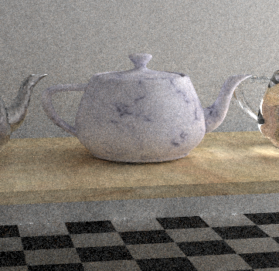
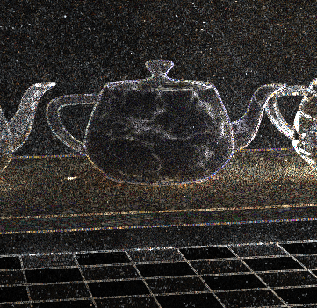
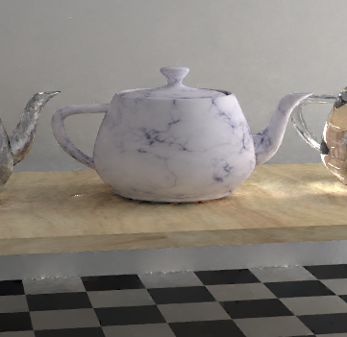
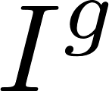
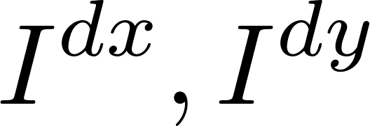

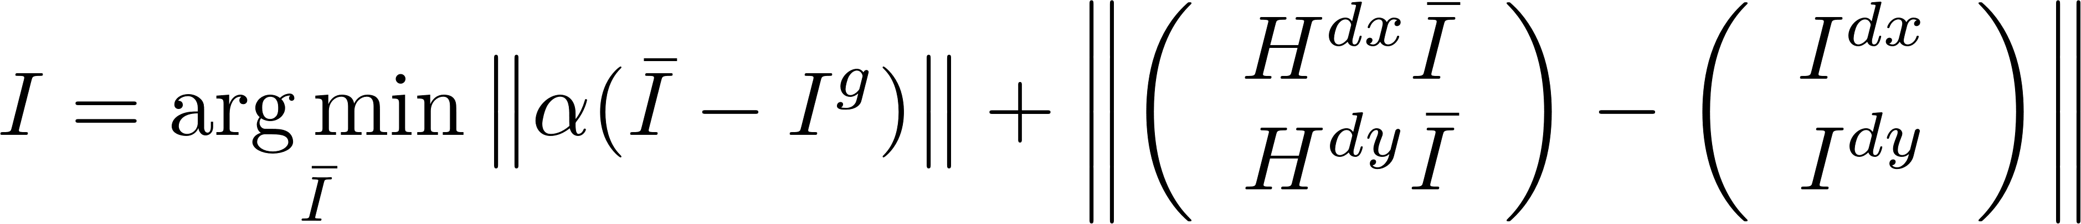
Poisson reconstruction
+
Base image
Gradients
Reconstruction
Image fidelity
Gradient fidelity
Under L2-Norm: Unbiased estimate of true image
Notes:
To obtain the final image in gradient-domain rendering the generated base and gradient images are used to guide the reconstruction process for the output image.
This is done by using a screened poisson reconstruction.
In the equation below you see that we minimize a equation system to find a image I that is as similar as possible to the base image I_g and that has also gradients that are as similar as possible to the sampled gradients I_dx and I_dy.
H^dx and H^dy are the horizontal and vertical gradient operators, producing finite difference gradients of an input image.
The scalar constant alpha controls how much we weight the base image compared to the gradient information.
Under the L2 norm, this reconstruction gives us an unbiased estiamte of the true image.

Slide 14
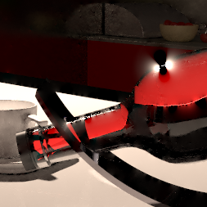
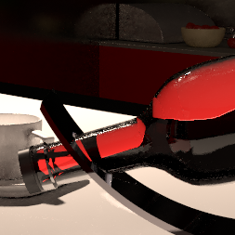
Poisson reconstruction
In practice: problems with conflicting gradient information
L2-norm: unbiased
L1-norm: biased
Notes:
Even though unbiased, the reconstructed image can suffer from strong artifacts, as shown in the image on the left. In practice it’s beneficial to use the L1-norm instead. This adds a small amount of bias, but removes many artifacts in the reconstruction.

Slide 15
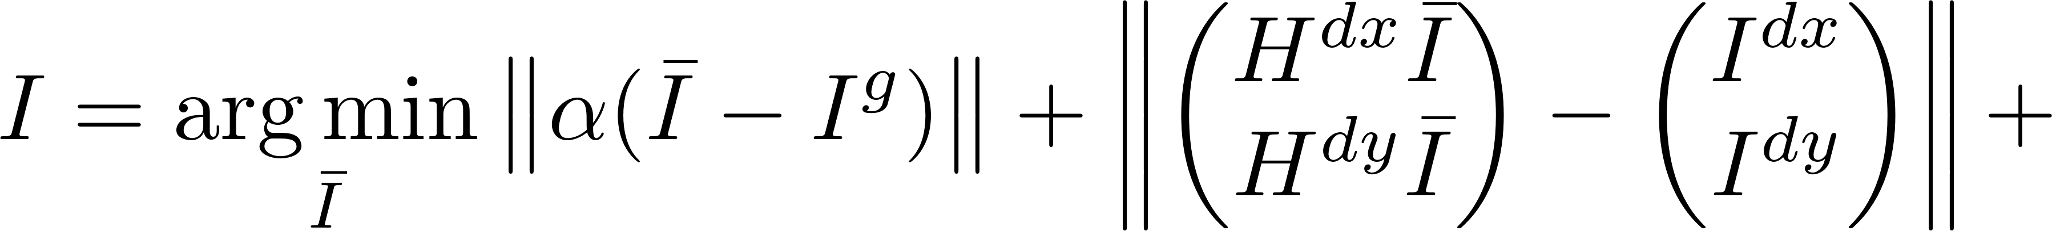


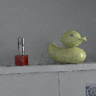
Extending the reconstruction
Goal: Make reconstructed image piecewise smoother by adding additional constraints
Feature constraint
Image fidelity
Gradient fidelity
...
Normals
Textures
L1-reconstruction
Notes:
To make the output smoother, we add a new constraint to our poisson reconstruction. We base this constraint on the image features we sample alongside the rendering process.

Slide 16
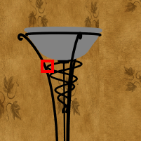
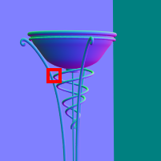
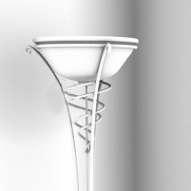
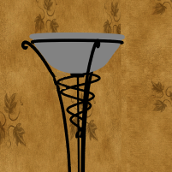
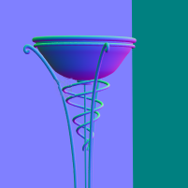



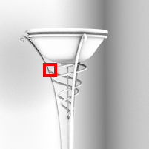











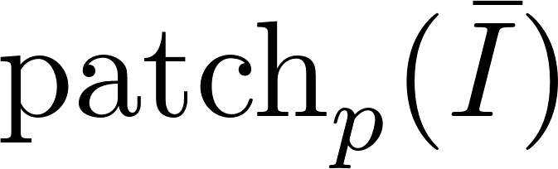










Feature constraint
Unknown Image
Texture
Normal
Position
AO
?
SVD
≈ weighted
sum of:
Truncate SVD (remove noise)
Notes:
We regularize the reconstruction in the following way. In the unknown image on the left and the sampled features on the right, we look at a small patch centered around a pixel p.
We interpret each channel of each feature as a separate feature.
We then orthogonalize the features by using a singular value decomposition.
We then say that the small patch centered around pixel p should be close to a weighted sum of the ortogonal feature basis.
In practice we use a truncated SVD and only use the first few feature vectors. By that we get rid of the noise captured in the vectors corresponding to the smallest singular values.

Slide 17

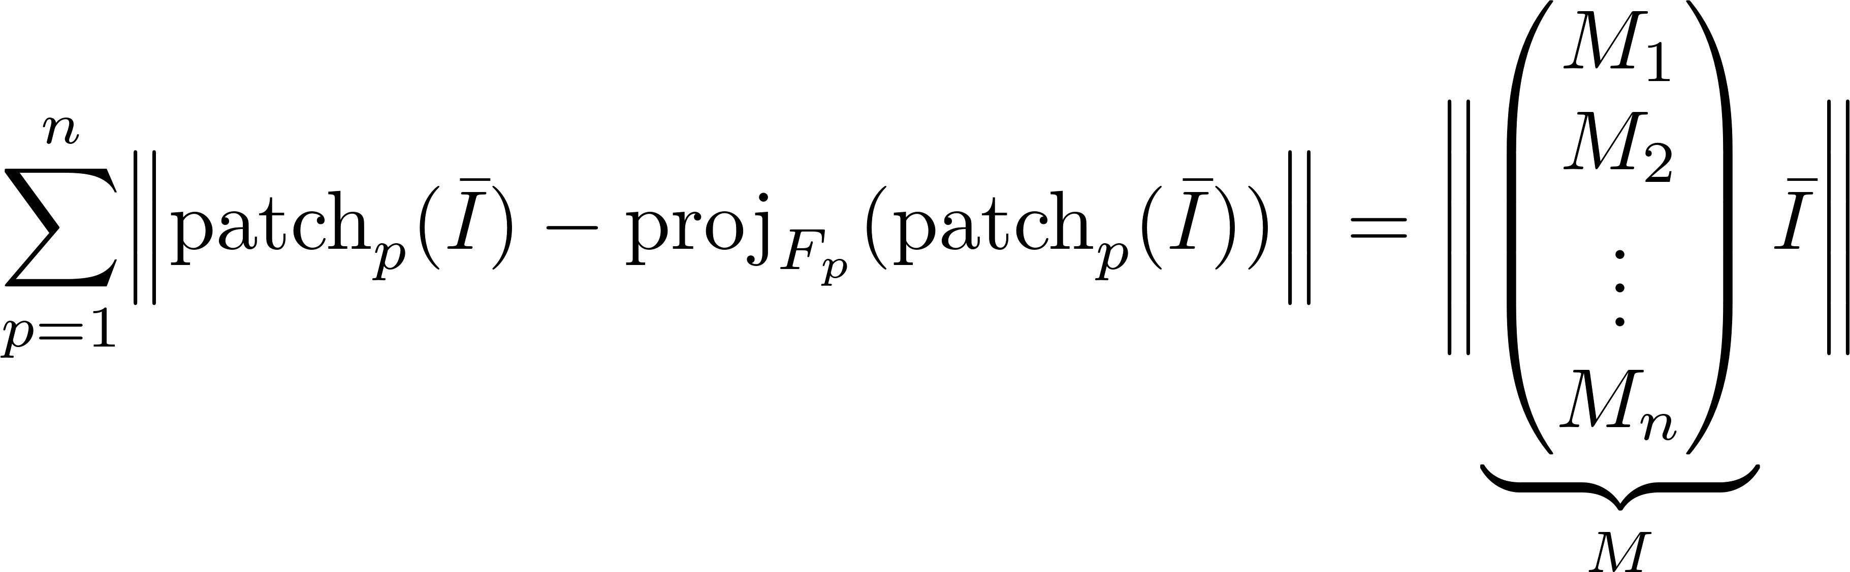
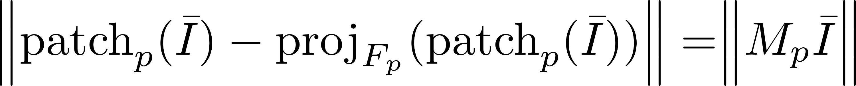
Extending the Reconstruction
Close to a weighted sum of vectors close to the subspace spanned by these vectors
We want to minimize
Reconstructed patch
Span of feature vectors
Patch constraints for each pixel
Notes:
We can formalize this constraint of being close to a weighted sum of features in the following way.
Being close the weighted sum of vectors is the same as being close the the subspace spanned by these vectors.
In our case this means we want to minimize the distance between the patch in the reconstructed image and ist projection onto the feature vectors.
Here F_p denotes the span of feature vectors.
Since all these operations are linear we can write it using an appropriate matrix B_p
We then add patch constraints for each pixel, so we simply sum up the patch constraint terms over all pixels. In matrix notation this means we simply stack up all matrices M1…Mn into one big matrix
Which we call M.

Slide 18
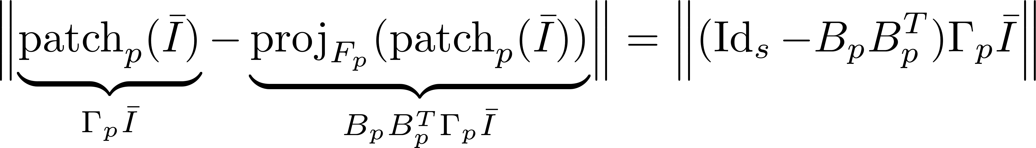
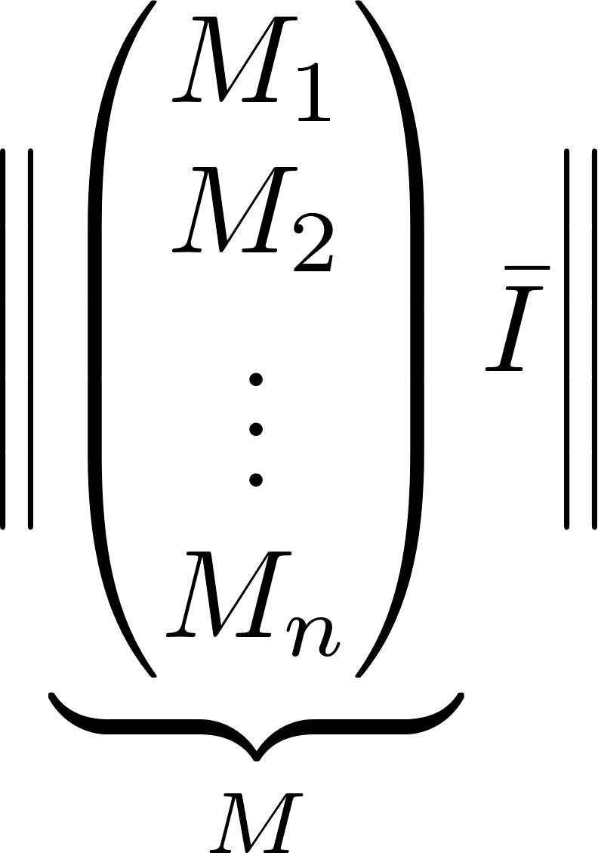
Feature constraint
Linear algebra formulation:
Patch constraints for each pixel stacked up
Notes:
We can formulate this constraint using basic linear algebra. The notion of being close to a weighted sum of vectors is exactly the same as being close to the projection onto the subspace spanned by these vectors.
This means we want the patch to be close to its projection onto the subspace spanned by the feature vectors. We denote this subspace by F_p
We can then write these operators in matrix form. Gamma_p is the matrix which selects a small patch centered around pixel p.
The matrix B_p contains the feature vectors as columns.
We then add patch constraints for each pixel and stack them up into one big matrix for notational conveniance. We call this matrix «M»

Slide 19
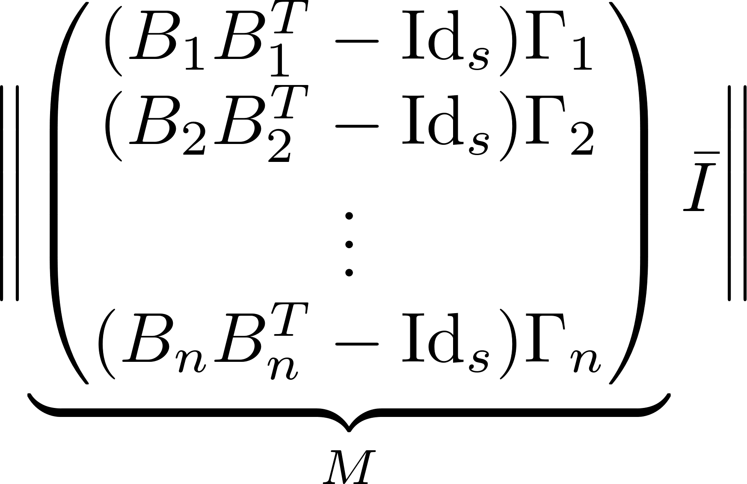
Feature constraint
Linear algebra formulation:
Patch constraints for each pixel stacked up
Notes:
We can formulate this constraint using basic linear algebra. The notion of being close to a weighted sum of vectors is exactly the same as being close to the projection onto the subspace spanned by these vectors.
This means we want the patch to be close to its projection onto the subspace spanned by the feature vectors. We denote this subspace by F_p
We can then write these operators in matrix form. Gamma_p is the matrix which selects a small patch centered around pixel p.
The matrix B_p contains the feature vectors as columns.
We then add patch constraints for each pixel and stack them up into one big matrix for notational conveniance. We call this matrix «M»

Slide 20
Regularized reconstruction
➔ Still linear system of equations
Image fidelity
Gradient fidelity
Patch constraints
Notes:
Our regularized reconstruction then looks like this. We still have the image fidelity and gradient fidelity terms and added are new patch constraints. Here all the constraints are summorized in one big matrix M.
Beta here is a scalar weighting factor controlling the strength of the new constraints.
Adding these constraints makes the optimization more compilcated, but ist still possible to solve it in reasonable time, since the whole problem is still simply an overdetermined system of linear equations,

Slide 21
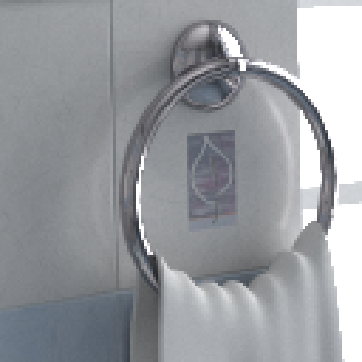
















Problems
Reconstruction not consistent!
Converged image
Projection onto feature subspace
Converged image
Local feature vectors
Notes:
In practice this formulation however has one fundamental problem.
Ideally, the converged image should be locally exactly the sum of local feature patches.
For some image regions the converged image actually is identical to ist projection onto the feature subspace,
But for some others this is clearly not the case.
This makes the reconstruction not conistent. This means the result of the extended reconstruction will not converge to the correct image, even if we compute an
Infinite number of samples.

Slide 22
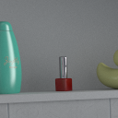

















Problems
Reconstruction not consistent!
Converged image
Projection onto feature subspace
Converged image
Local feature vectors
Notes:
In practice this formulation however has one fundamental problem.
Ideally, the converged image should be locally exactly the sum of local feature patches.
For some image regions the converged image actually is identical to ist projection onto the feature subspace,
But for some others this is clearly not the case.
This makes the reconstruction not conistent. This means the result of the extended reconstruction will not converge to the correct image, even if we compute an
Infinite number of samples.

Slide 23

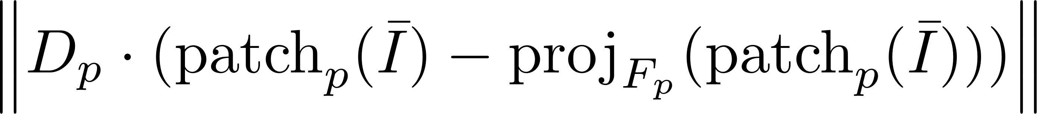
Solution
Constraint weights for each pixel
Weights get more restrictive as variance decreases: reconstruction is consistent
Not important to fit
After infinite number of samples:
.*
Important to fit
Error for each
pixel in a patch
Notes:
Fortunately there is a relatively straight forward solution to this problem. We can simply multiply our constraints by an additional weighting term.
We take our error for each pixel in a small patch and multiply it by per-pixel weighting factors. In this example we have some pixels which are less important to fit, and some are more important. The weights are based on NL-means and crossbilateral filtering, essentially measuring the distance of each pixel to the central pixel.
We then make the weights get more restrictive as variance decreases and thus the reconstruction is consistent. In the limit only the central pixel will have a weight

Slide 24
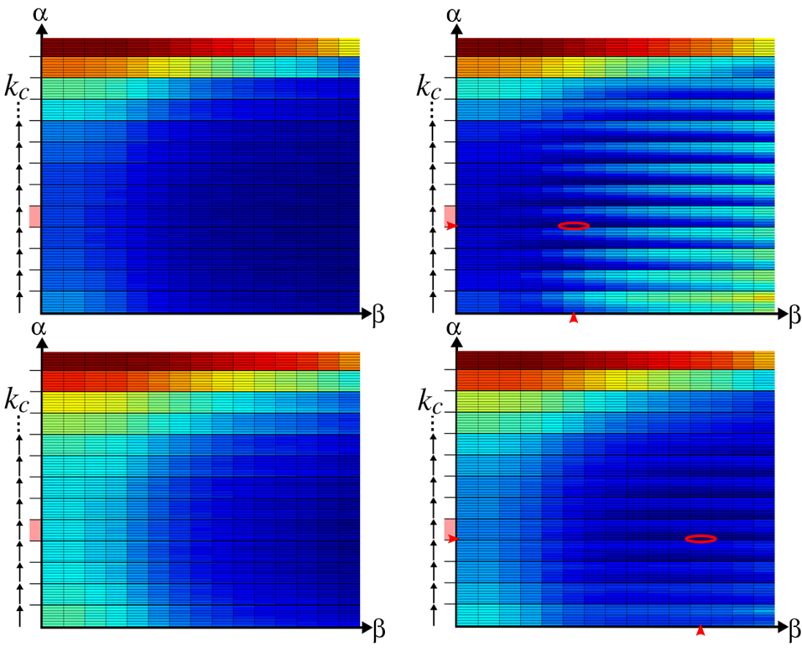
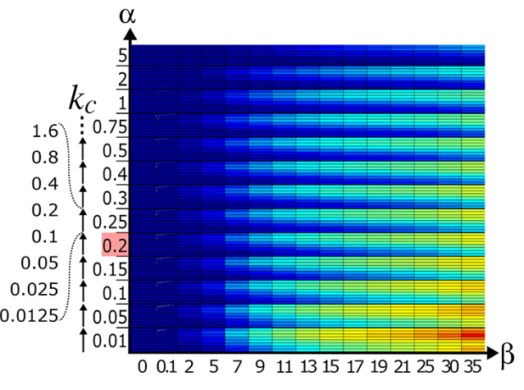
Analysis
Low noise
Base image weight
Beta: Bias-Variance-Tradeoff
Optimal alpha independent of noise level (as in [Kettunen et al. 2015])
High noise
Patch constraint weight
Squared bias
+
Variance
=
MSE
Notes:
Under some slight simplications we can do an analytic error analysis for our method.
Here we plot squared bias over our reconstruction paraneters. The parameters are the base image weight alpha, the patch constraint weight beta and k_c, which controls the restrictiveness of the constraint weighting. As you can see, bias increaseases as we increase the parameter beta and lower the parameter alpha.
We then plot the variance for a scenario with low noise. The optimal parameters with respect to MSE are marked using this red ellipse.
If we plot the variance and MSE for a higher noise scenario we see that the ellipse basically shifts to the right. This means that the optimal alpha to chose stays the same and does not
depend on the noise level. Beta offers a bias variance trade-off

Slide 25
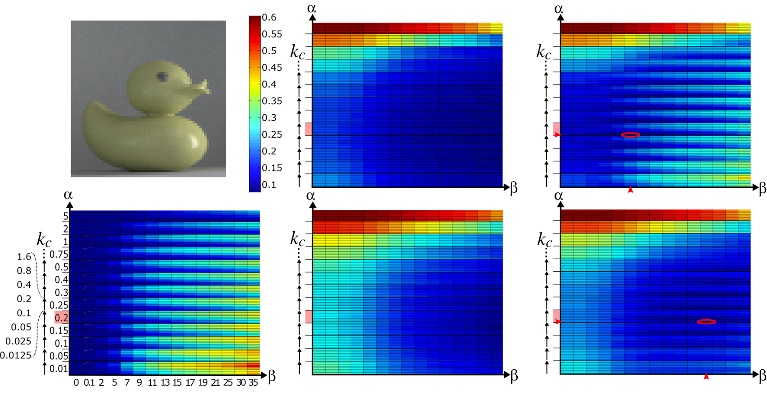
Analysis
Evaluated image region
Low noise
Optimal alpha independent of noise level (as in [Kettunen et al. 2015])
Beta: Bias-Variance-Tradeoff
Bias disappears if converged image fits patch constraints
High noise
Base image weight
Patch constraint weight
Squared bias
Variance
MSE
Notes:
Under some slight simplications we can do an analytic error analysis for our method.
Here we plot squared bias over our reconstruction paraneters. The parameters are the base image weight alpha, the patch constraint weight beta and k_c, which controls the restrictiveness of the constraint weighting. As you can see, bias increaseases as we increase the parameter beta and lower the parameter alpha.
We then plot the variance for a scenario with low noise. The optimal parameters with respect to MSE are marked using this red ellipse.
If we plot the variance and MSE for a higher noise scenario we see that the ellipse basically shifts to the right. This means that the optimal alpha to chose stays the same and does not
depend on the noise level. Beta offers a bias variance trade-off

Slide 26
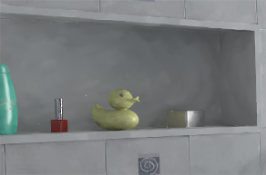

Parameter setting
Global parameter settings not appropriate
Small β for patch constraints
High β for patch constraints
Notes:
Highlight regions where global parameter settings are not optimal
Conclusion: need local parameter settings

Slide 27
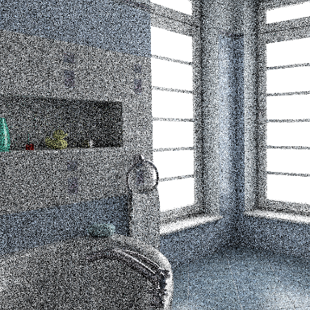
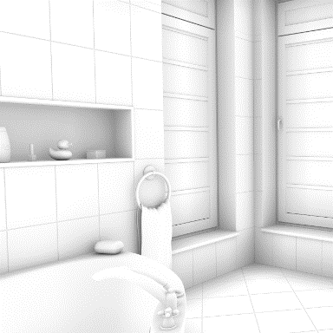
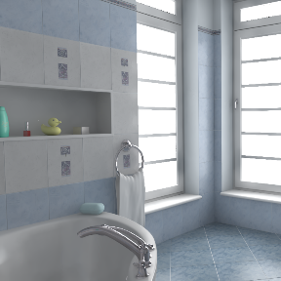
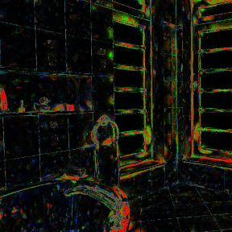

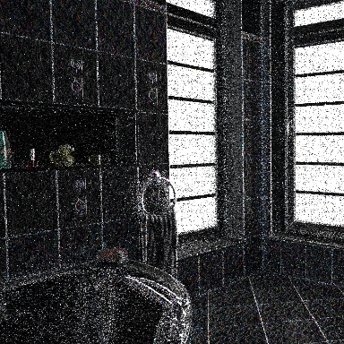






Multiscale reconstruction pipeline
[Rousselle et al. 2011]
Input: Base image, gradients and features
Candidate reconstructions
Selection map
Output
Different α, β, k_{c} parameters
Error estimation

Slide 28
Multiscale reconstruction pipeline
[Rousselle et al. 2011]
Input: Base image, gradients and features
Candidate filters
Selection map
Output
Different α, β, k_{c} parameters
Error estimation

Slide 29
Candidate reconstructions
Compute three reconstructions with different (α, β, k_{c}) parameters
Brute force search over triplets of scales selected from 360 scales over set of training images (360³ combinations)
Notes:
(stay on high level)

Slide 30




Error estimation
Variance
Two buffer estimate
Bias
Smoothed difference between reconstruction and base image
Error
MSE=Bias^2 + Var
Error
Ground truth MSE
[Rousselle et al. 2012]

Slide 31







Scale selection
Error: 0.0045
Error: 0.0055
Our selection
Reference selection
Error: 0.0085
Our combination
Reference combination
Error: 0.0034
Error: 0.0026
Scales
Notes:
Smooth selection to avoid selection artifacts
In the visualization the selection is weighted such that areas where all scales have a low error appear black, since there the selection does not really matter that much.
Error of our combination lower than error of individual scales and result fairly close to reference combination.

Slide 32




Results
Bathroom, 7 min
Ours
PT + RDFC
G-PT
(L1)
PT
-
7 min = Rendering 6 min + Reconstruction (CUDA) 1 min

Slide 33









Results
Bathroom, 7 min
Reference
Ours 0.00126
PT + RDFC 0.00142
G-PT (L1) 0.00662
PT 0.05527

Slide 34
Results
Bathroom, 7 min
Reference
Ours 0.00126
PT + RDFC 0.00142
G-PT (L1) 0.00662
PT 0.05527

Slide 35


Results
Notes:
A few sentences of discussion to comment on this
This plot shows the error reduction as we increase render time. Note that our method consistently improves over RDFC, independent of the sampling rate.

Slide 36




Results
Bookshelf, 23 min
Ours
PT + RDFC
G-PT
(L1)
PT
-

Slide 37










Results
Bookshelf, 23 min
PT
0.03257
G-PT (L1) 0.00352
PT + RDFC 0.00085
Ours 0.00075
Reference

Slide 38
Results
Bookshelf, 23 min
Reference
Ours 0.00075
PT + RDFC 0.00085
G-PT (L1) 0.00352
PT
0.03257

Slide 39




Results
Bottle, 14.5 min
Ours
BDPT + RDFC
G-BDPT
(L1)
BDPT
-

Slide 40










Results
Bottle, 14.5 min
BDPT 0.00121
G-BDPT (L1)
0.00063
PT + RDFC 0.00050
Ours 0.00042
Reference

Slide 41
Results
Bottle, 14.5 min
Reference
Ours 0.00042
PT + RDFC 0.00050
G-BDPT (L1)
0.00063
BDPT 0.00121

Slide 42
Conclusions
Significant improvement over L1-Reconstruction
Low overhead compared to rendering times (ca. 1 min for a 1 mega-pixel image)
Path tracing
G-PT (L1)
Ours
Notes:
In conclusion we presented a novel reconstruction for gradient domain rendering which significantly outperforms the previous L1 reconstruction
This is done at a relatively small overhead.

Slide 43
Future work
Improved gradient sampling
Adaptive sampling
Temporal consistency
Notes:
In terms of future work there are multiple things one could do.
First, we believe that most likely the gradient domain path tracing itself can still be improved. The quality of our results depend on highly on the quality of the sampled gradients. Especially if specular materials are involved, gradient sampling can become quite tricky and gradient domain rendering is not as effective anymore. Improvements to GPT would most likely benefit the results of our method as well.
Also, we did not combine our method with adaptive sampling. This should be fairly straightforward to do and could further improve the results.
Our method currently also does not enforce any temporal consistency. Thus if you reconstruct animations you can expect some flickering to occur.

Slide 44
Acknowledgments
Swiss National Science Foundation project Nr. 143886
Slide Credits: Markus Kettunen, Fabrice Rousselle
Code available soon at http://www.cgg.unibe.ch/
Notes:
We like to acknowledge our funding agency the swiss national science foundation and markus kettunen and fabrice rousselle who helped to prepare some of the slides I showed you.
The implementation of our paper will soon be available on the computer graphics group webpage.

